Slide 1
Edrington D.A.I.P project: Optimal selection of suppliers
29th January 2019

Slide 2
Contents
Who we are
Edrington and GSC S&D
Supplier Selection and Utilisation problem
Introduction to concepts
Criteria-Constraints and Limitations
Problem Definition
Contact Details and Useful Links

Slide 3
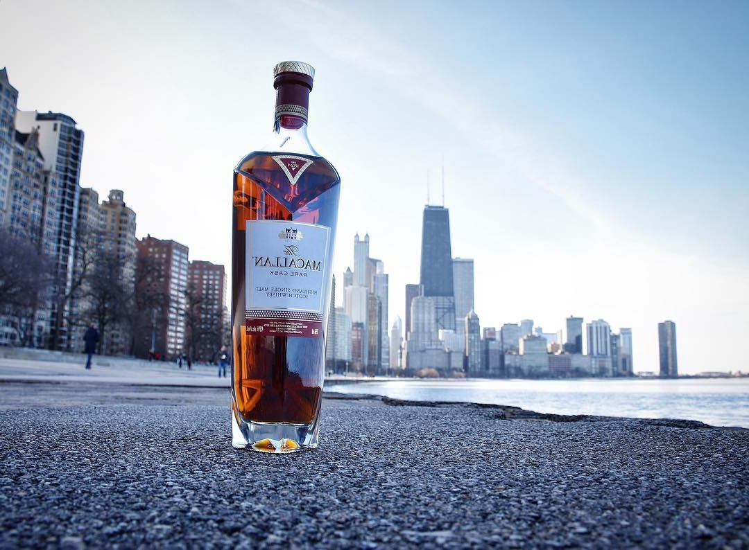
Who we are
In Edrington we take pride that we make some of the world’s best-loved Scotch whiskies, including The Macallan, The Famous Grouse, Highland Park and The Glenrothes.
The portfolio is complemented by Brugal, the leading premium rum in the Caribbean, and by Snow Leopard vodka.
Notes:
According to A recent Report

Slide 4

Who We Are- GSC S&D
Operations Vision – Unity of purpose
Strategy Planning
Whisky Supply Planning
Supply Chain Logistics
Global decision-making
Demand Forecasting
Demand Planning
Purchasing
Technological Development
“To be the leading premium spirits supply chain,
driven by quality and service”

Slide 5
Basic concepts
To fully understand the problem and the challenges behind the project it is important to comprehend the concepts of:
1 Required Materials
2 Status Quo
3 Near Future Vision

Slide 6

Materials
Glass
Labels
Aluminium Closures
Sub Assembly
Capsules
Cork
Outer cases
Gift Cartons

Slide 7
Edrington supply context – last 10 years
Company 0 –17% last 5 years - £3m
Company 1 – 2% - £0.5m
Company 2 – 15% - £2.9m
Company 3 – 25% - £4.0m until 2018
Company 4 – 28% - £5.4m

Slide 8
Status Quo – Near Future
Where we are
Supplier Selection and Utilisation is entirely based on the experience of the procurement team.
The Vendor Ratings are used only to motivate the suppliers
Where we want to be
Use a model that will work as a guideline for the procurement team to help them select the optimal combination of suppliers per month in order to minimise the cost with the highest possible quality.
Supplier selection is the multivariate analysis and performance measurement of the vendors of a firm to enhance its effectiveness and competitiveness (Bhutta & Huq, 2002).

Slide 9
Criteria and Constraints for supplier selection
Vendor Ratings for the last two financial quarters
OTIF (On time and In Full deliveries), Material Quality and Overall Rating
Type of Glass (Standard, Premium)
Colour
Cullet%
Percentage of recycled glass in the bottles. The higher the percentage of recycled glass the more opaque the final bottle will be.
Price per gram
Demand (orders for next month)
Capability of Supplier to Produce (in bottles per product type)
Lead times per Vendor
The time required by each vendor between initial order and final delivery.

Slide 10
Further Criteria for Supplier Selection
Additionally:
Qualitative Criteria
Strategic Importance of the Supplier to Company
Level of relationship between suppliers and Edrington
Supplier Capability in other aspects /technology
External Factors
Supporting Community Initiatives
Cost reduction Initiatives
And more.

Slide 11
Problem definition
Build a model that will optimise utilisation of the the suppliers based on the prior criteria (quantitative only) and constraints.
To build the model you can make assumptions and even build scenarios that will change the acceptable level of your constraints.
The scenarios (if used) must be realistic and reflect to potential circumstances.
You can use:
Excel with the use of the engine of your choice (Solver, Open Solver, Gurobi etc.)
R
Python

Slide 12
Deliverables
Optimisation Model
Report:
Up to 5 pages
Explain the model
Explain the assumptions and scenario (if used)
Recommendations
Code (if used)
Presentation of the model and assumptions

Slide 13
Contact details & Useful links
Email: Ioannis.Varvitsiotis@Edrington.com
Each group can send up to two emails
Glass making videos:
https://www.youtube.com/watch?v=dOsXOsb7oz4
https://www.youtube.com/watch?v=HwoMDBM4Mq4
https://www.youtube.com/watch?v=A_M8WBJMcM0

Slide 14
Thank You

